Slide 1
PowerShell Basics

Slide 2
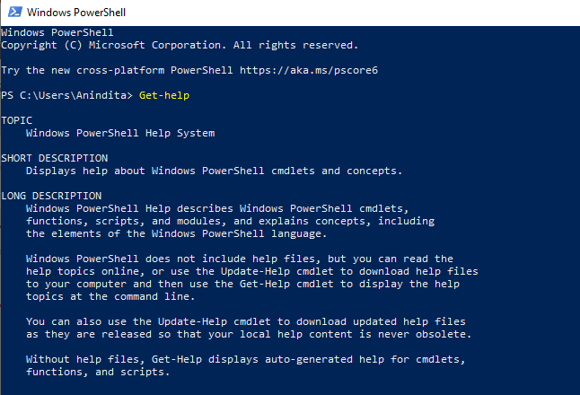
What is PowerShell
PowerShell is a cross-platform task automation solution made up of a command-line shell, a scripting language, and a configuration management framework. PowerShell runs on Windows, Linux, and macOS.

Slide 3
PowerShell command shell
PowerShell is a modern command shell that includes the best features of other popular shells.
Unlike most shells that only accept and return text,
PowerShell accepts and returns .NET objects. The shell includes the following features:
Robust command-line history
Tab completion and command prediction (See about_PSReadLine)
Supports command and parameter aliases
Pipeline for chaining commands
In-console help system, similar to Unix man pages

Slide 4
Scripting Feature
As a scripting language, PowerShell is commonly used for automating the management of systems. It is also used to build, test, and deploy solutions, often in CI/CD environments. PowerShell is built on the .NET Common Language Runtime (CLR). All inputs and outputs are .NET objects. No need to parse text output to extract information from output. The PowerShell scripting language includes the following features:
Extensible through functions, classes, scripts, and modules
Extensible formatting system for easy output
Extensible type system for creating dynamic types
Built-in support for common data formats like CSV, JSON, and XML

Slide 5
PowerShell Automation
The extensible nature of PowerShell has enabled an ecosystem of PowerShell modules to deploy and manage almost any technology you work with. For example:
Microsoft
Azure
Windows
Exchange
SQL
Third-party
AWS
VMWare
Google Cloud

Slide 6
PowerShell Desired State Extension (DSC)
PowerShell Desired State Configuration (DSC) is a management framework in PowerShell that enables you to manage your enterprise infrastructure with configuration as code. With DSC, you can:
Create declarative configurations and custom scripts for repeatable deployments
Enforce configuration settings and report on configuration drift
Deploy configuration using push or pull models

Slide 7
PowerShell cmdlets
Cmdlets are native PowerShell commands, not stand-alone executables. Cmdlets are collected into PowerShell modules that can be loaded on demand. Cmdlets can be written in any compiled .NET language or in the PowerShell scripting language itself.

Slide 8
Install cmdlets
PowerShell uses a Verb-Noun name pair to name cmdlets.
For example,
the Get-Command cmdlet included in PowerShell is used to
get all the cmdlets that are registered in the command shell.
The verb identifies the action that the cmdlet performs,
and the noun identifies the resource on which the cmdlet performs
its action.

Slide 9
Usage of PowerShell
Usage of PowerShell has grown since the days when it was Windows-only. It's still used for Windows task automation, but today, you can use for a variety of tasks like:
Cloud management. PowerShell can be used to manage cloud resources. For example, you can retrieve information about cloud resources, as well as update or deploy new resources.
CI/CD. It can also be used as part of a Continuous Integration/Continuous Deployment pipeline.
Automate tasks for Active Directory and Exchange. You can use it to automate almost any task on Windows like creating users in Active Directory and mailboxes in Exchange.

Slide 10
Using PS cmdlets
PowerShell includes cmdlets that help you discover PowerShell. Using
these three cmdlets, you can discover what commands available,
what they do, and what types they operate on.
Get-Verb. Running this command returns a list of verbs that most commands
adhere to. The response includes a description of what these verbs do.
As most commands follow this naming, it sets expectations on what a command
does. This helps you select the appropriate command and what to name
a command, should you be creating one.
Get-Command. This command retrieves a list of all commands installed
on your machine.
Get-Member. It operates on object based output and is able to
discover what object, properties and methods are available for a command.
Get-Help. Invoking this command with the name of a command
as an argument displays a help page describing various parts of a command.

